Slide 1
CSS - Basics

Slide 2
Introduction
CSS stands for Cascading Style Sheets.
CSS saves a lot of work.
It can control the layout of multiple web pages all at once.

Slide 3
How to add CSS in HTML
CSS can be added to HTML documents in 3 ways
Inline - by using the style attribute inside HTML elements
Internal - by using a <style> element in the <head> section
External - by using a <link> element to link to an external CSS file

Slide 4
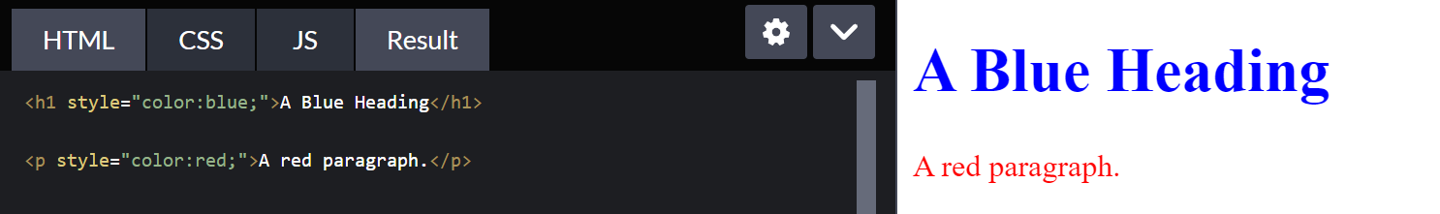
Inline CSS
An inline CSS is used to apply a unique style to a single HTML element.
An inline CSS uses the style attribute of an HTML element.

Slide 5
Internal CSS
An internal CSS is used to define a style for a single HTML page.
An internal CSS is defined in the <head> section of an HTML page, within a <style> element.

Slide 6
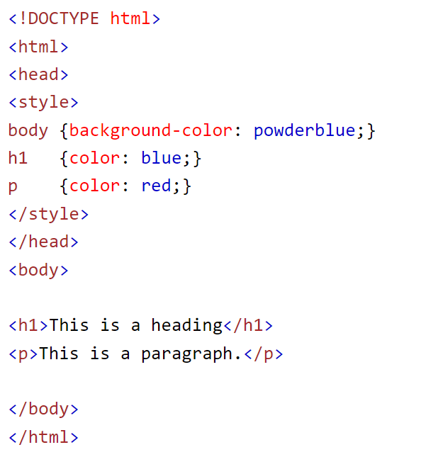

Slide 7
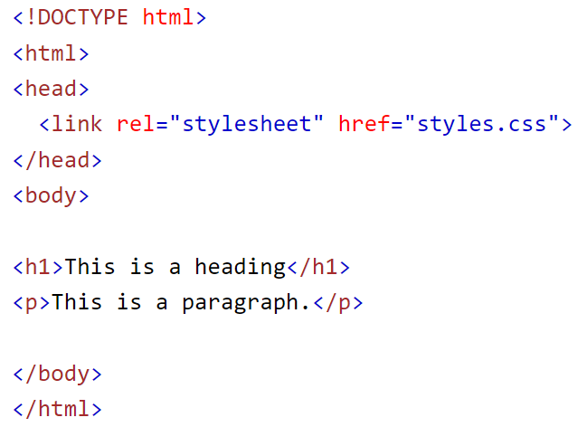
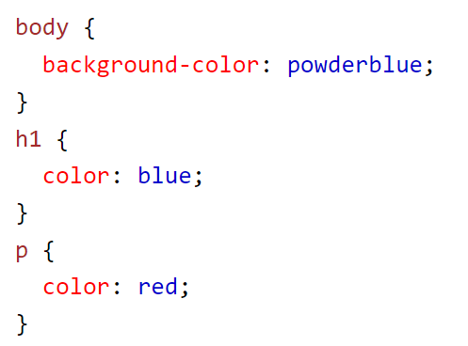
External CSS
An external style sheet is used to define the style for many HTML pages.
To use an external style sheet, add a link to it in the <head> section of each HTML page

Slide 8
Class And ID Attribute in HTML Element

Slide 9
Margin, Padding in CSS

Slide 10
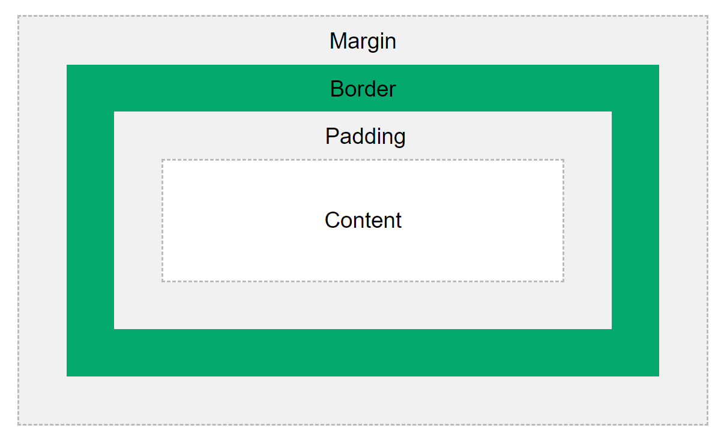
CSS Box Model

Slide 11
Box Model Explanation
Explanation of the different parts:
Content - The content of the box, where text and images appear
Padding - Clears an area around the content. The padding is transparent
Border - A border that goes around the padding and content
Margin - Clears an area outside the border. The margin is transparent

Slide 12
